Slide 1
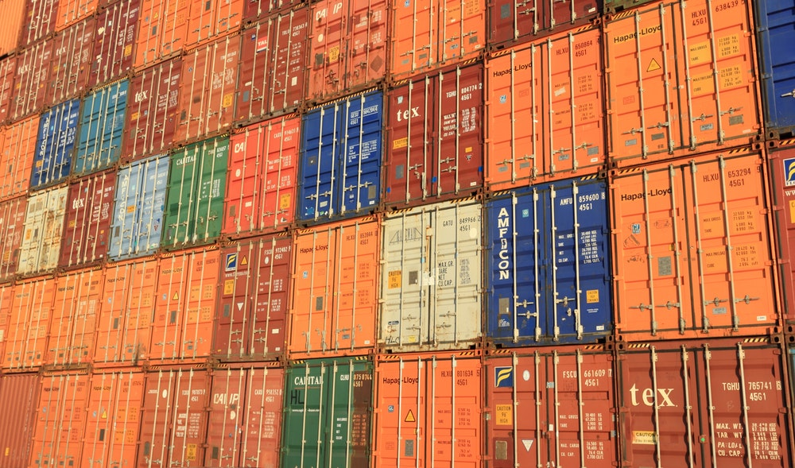
UIIA Educational Session – MC Frequently Asked Questions
Presentation for Harbor Trucking Association
February 20, 2024 – 2:00 p.m. (EST)

Slide 2
Administration of the UIIA - Intermodal Interchange Executive Committee
Role of the IIEC and Consist of the Committee
The Intermodal Interchange Executive Committee (IIEC) is the ten-member group of industry representatives that oversees and governs the administration of the UIIA.
Comprised of UIIA participants from the Motor, Ocean, Rail and Equipment Leasing Company sectors.
Has ultimate decision-making authority regarding the UIIA.
Meets three times a year (February, May & October) to discuss UIIA issues and concerns.
Continually reviews the UIIA to ensure the document reflects current industry practices.
Annual review of the IIEC membership is conducted each year by the IIEC Appointment Committee that is appointed by IANA’s Board of Directors.

Slide 3
Intermodal Interchange Executive Committee
2024 IIEC Membership
MC IIEC Members | MC IIEC Alternates
Ben Banks, TCW, Inc. | Zachary Moffa, Evans Delivery Co., Inc.
Dave Hensal, Eagle Systems, Inc. | Peter Schneider, T.G.S. Transportation, Inc.
Kevin Lhotak, Reliable Transp. Specialists, Inc. | Matt Sciascia, Knight Transportation Service, Inc.
OC IIEC Members | OC IIEC Alternates
Leo Imperial, Mediterranean Shipping Co. | Ronnie Armstrong, Ocean Network Express (NA), Inc.
Jim Michalski, Zim Amer. Integrated Shipping | Ryan Koch, Evergreen Shipping Agency
Al Smeraldo, Maersk Agency USA | Phillip Summers, Hapag Lloyd (America), Inc.
Rail IIEC Members | Rail IIEC Alternates
Gordon Graham, Canadian National Railway Co. | Steven Chavez, BNSF Railway
Andrew Knouse, Norfolk Southern Corp. | James Palmer, CSX Intermodal Terminals Inc.
Tim Moore, CSX Intermodal Terminals, Inc. | Nick Smith, Union Pacific Railroad
Equipment Leasing Company Member | Equipment Leasing Companies Alternates
Nathaniel Seeds, Flexi-Van Leasing LLC | EJ Bronwasser, Milestone Equipment Holdings Jeffrey Dudenhefer, North American Chassis Pool Cooperative LLC

Slide 4
Intermodal Interchange Executive Committee (IIEC)
IIEC Appointment Process
IIEC Appointment Committee (IAC) is appointed by IANA’s Board of Directors and is comprised of four sitting IANA Board members that are also UIIA participants. There is one representative from each sector – Rail, Marine, Motor Carrier and Equipment Leasing Company.
Committee membership is reviewed on an annual basis by the IIEC Appointment Committee. This review is conducted in the fourth quarter of each year.
A notification is sent to UIIA participants each year to solicit IIEC membership candidates. This is normally sent out in October of each year.
UIIA participants interested in serving on the IIEC should complete the IIEC Appointment form and include a copy of their resume. The information should be sent via e-mail to debbie.sasko@intermodal.org. Applications received that meet the IIEC Appointment criteria will be forwarded to the IAC for review and consideration.
The IAC will submit their recommendations for any changes to the IIEC membership for the following year to IANA’s Board of Directors for final decision at its January meeting.

Slide 5
Administrative Procedures of the UIIA
EP Addenda Review Process
UIIA EPs may submit requests to amend their addenda to the UIIA.
Revisions related to economic terms in the EP’s addendum are not within the purview of the IIEC’s review. Based on antitrust laws, IANA is prohibited from restricting an EP’s commercial terms.
Non-commercial EP addenda changes such as those related to processes are reviewed by the IIEC members representing the mode involved in the revision.
The Committee’s review of addenda language is solely to determine if the proposed language poses a conflict or is inconsistent with the base terms of the UIIA.
If the modal IIEC review results in adverse comments on the proposed language, then a conference call of the modal IIEC members is scheduled to discuss the concerns prior to providing the final summary of the IIEC’s review to the EP that submitted the proposed revision.
A summary of the results of the modal IIEC review is provided to the EP that requested the change. A conference call is then held between the EP and the modal IIEC members to provide the EP an opportunity to address the concerns raised during the modal IIEC review.

Slide 6
Administrative Procedures of the UIIA
EP Addenda Review Process - continued
At the conclusion of the conference call with the EP, the modal IIEC members vote to confirm whether the proposed language is inconsistent with or poses a conflict with the base terms of the UIIA.
The proposed language will be approved only if the majority of the modal IIEC members participating on the call vote that the language does not conflict with or is not inconsistent with the UIIA.
If the results of the vote is that the proposed revision does pose a conflict with or is inconsistent with the Agreement, the item is placed on the agenda for review and vote by the full IIEC Committee at its next scheduled meeting.
Once a proposed modification to an EP’s addendum is approved it requires a thirty-day notice to the Motor Carriers.
Should a MC not agree with the EP’s modification it has the right to make a commercial decision to elect not to do business with the specific EP. The MC should have their insurance agent remove the EP as an additional insured on their insurance policy(ies) so that their company no longer shows approved for the specific EP under the UIIA.

Slide 7
Administrative Procedures of the UIIA
Requests for Modifications to the UIIA
Any UIIA signatory may submit a request for a modification to the UIIA. The formal request must be submitted in writing and include:
Proposed language to be considered by the IIEC.
The purpose and intent of the proposed change to the UIIA.
Requests for modifications should be submitted via e-mail to debbie.sasko@intermodal.org.
Requests will be forwarded to the IIEC for review and consideration at its next scheduled meeting.

Slide 8
Administrative Procedures of the UIIA
Process for Modifying the UIIA
Modifications to the UIIA are reviewed and considered by the IIEC.
Revisions to the Agreement require a 3/4th majority vote of the voting members in attendance at the meeting or participating via teleconference for the proposed modification to pass.
If a modification is approved, the proposed revision is posted on the UIIA website and is sent out to all UIIA participants for a thirty-day (30) comment period.
Any comments received are forwarded to the Committee for review and to vote on how to proceed regarding the proposed revision.
All UIIA participants are notified of the IIEC’s decision regarding the proposed modifications and if approved, the effective date of the revisions must be at least 15 days from the Committee’s decision.
A copy of the revised UIIA will be posted on the UIIA website.

Slide 9
Administrative Procedures of the UIIA
Enforcement of the UIIA
Default Dispute Resolution (Section H.1.)
The UIIA contains a default dispute resolution process (Section H.1.) that provides terms for parties to utilize for invoice disputes resulting from per diem, M&R and equipment use/rental charges. The terms in Section H.1. would be applicable only if the EP does not have its own dispute resolution process within its addendum.
Binding Arbitration Process (Exhibit D of the UIIA)
Exhibit D of the UIIA provides a binding arbitration process that UIIA participants can elect to utilize as an alternative method for resolving disputed matters.
Compliance w/the Agreement (Admin. Procedures, Section VIII. Items C & D)
Certain verified violations of the UIIA (unrelated to commercial issues arising from an EP’s Addendum) can result in the IIEC cancelling a party’s participation in the UIIA.

Slide 10
MC UIIA FAQs
General Frequently Asked Questions Relating to the UIIA Insurance
How does a Motor Carrier report that they are exempt from carrying workers compensation insurance?
Submit a letter on the MC’s company letterhead stating the company is exempt and the reason for the exemption.
Letter must be signed by an authorized officer of the company.
The exemption will be valid for one year from date of receipt. A new exemption letter will need to be provided by the MC each year.
How does a Motor Carrier get an insurance requirement waived?
The base UIIA insurance requirements cannot be waived. If a Motor Carrier wants to request a waiver for an EP’s individual requirement for cargo, trailer interchange or workers compensation, they would need to contact the UIIA EP directly regarding this request. The decision to grant the waiver will be a business decision made by the specific EP.
How does the UIIA handle insurance expirations?
Insurance policies are expired at 12:01 a.m. the day of expiration.
Agents need to submit insurance renewals no later than the day before the policies are due to expire.
Renewal policies are moved into place upon the effective date.

Slide 11
FAQs Related to Section E.1. Equipment Return
Motor Carrier’s Responsibilities
Use the Equipment only for the purpose it was interchanged
Do not authorize use of the equipment to other parties, unless written or electronic consent of the EP is provided.
Return the Equipment to the original point of interchange unless EP directs the equipment to be returned to a satellite location as governed by the process set forth in Section E.1.b.
Make sure your contact information on file with the UIIA is up-to-date so that any equipment return notifications sent by the EP are successfully received.

Slide 12
FAQs Related to Section E.1. Equipment Return
Equipment Provider Responsibilities
Ensure satellite location information that is maintained via internet posting or through IANA’s Equipment Return Location Directory is kept up-to-date.
Provide required notice of changes to equipment return location to UIIA MCs.
If the equipment return location changes, then the EP is required to notify the MC via e-mail by 4:00 p.m. (local time) the business day prior to the change becoming effective.
Work with facilities to ensure they are aware of the EP’s obligation under the UIIA to provide advance notice of changes to equipment return locations.

Slide 13
FAQs Related to Section E.1. Equipment Return
Role of the Marine Terminal Operators
Marine terminal operators are not signatories to the UIIA so are not contractually obligated to the terms of the Agreement.
When terminal restrictions or limitations occur at a facility that impact equipment return capabilities, it is up to the UIIA EP to work with the marine terminals they use to ensure that this information is provided in a timely manner so the EP can notify the MC of these changes in accordance with Section E.1.b. of the UIIA.

Slide 14
FAQs Related to Section E.1. Equipment Return
Reporting Non-Compliance of Notification Requirements
What should a Motor Carrier do if the EP does not provide the proper notice of a change to equipment return location as required under Section E.1.b.?
Contact the EP via e-mail and make them aware that required notice of the change to the equipment return location was not provided.
Send an e-mail to uiiaissues@uiia.org and identify the EP that did not comply with the required notification along with the terminal and example of the non-compliance (i.e. terminal screenshot or e-mail).
UIIA staff will notify the specific EP of their obligations as a signatory to the UIIA regarding the required notification that must be provided should the equipment return location change.
Copy of the MC’s e-mail will be maintained and can be used as additional supporting documentation should the claim be submitted for arbitration.

Slide 15
FAQs Related to Section E.1. Equipment Return
Charges Related to Equipment Return – What is and is not covered under the UIIA
Charges Addressed Under the UIIA | Charges Not Addressed Under the UIIA
Per Diem Charges | MC Compensation for Services Rendered
Maintenance & Repair Charges | Storage Charges
Chassis Use/Rental Charges (if chassis provider is a UIIA EP)
Note:
Charges not addressed under the UIIA would need to be covered in a commercial transportation agreement between the MC and EP outside of the UIIA.
Section E.1.e. stipulates that nothing in Section E.1. of the UIIA should be interpreted to preclude the MC from receiving compensation for services rendered in these circumstances.

Slide 16
FAQs Related to UIIA – Billing Timeframes
Per Diem Charges –
Sixty (60) days from the date the Motor Carrier returns the equipment to the EP.
Timeline if Incorrect Party Billed: If incorrect party is invoiced, the EP may invoice the interchanging MC within 30 days from the date the incorrect party disputes the charges with the EP or within the original 60 day period, whichever is later. The above applies as long the EP issues the invoice to the correct MC within 90 days from the date on which the equipment was returned.
Maintenance & Repair Charges
Standard Gate System (manned) – No later than 165 calendar days from the date of interchange at the time the damage was documented.
AGS Gate System (unmanned) – No later than 120 calendar days from the date of interchange at the time the damage was documented.
Over-the-Road Repairs – No later than 90 calendar days from the date of the repair. EPs may adopt a shorter billing time within its addendum however, it would need to be reciprocal to both the EP and the MC.

Slide 17
FAQs UIIA – Dispute Resolution
How many days does a Motor Carrier have to dispute an invoice?
The Motor Carrier has thirty (30) days from the date of receipt of the EP’s invoice to dispute the charges. Disputes must be done in accordance with the dispute resolution process contained in the EP’s addendum. Absent a process within the EP’s addendum, then the default dispute resolution process in Section H.1. of the UIIA should be used.
How many days does the EP have to respond to a MC’s dispute?
The timeframe for the EP to respond to the dispute would depend on the terms in the dispute resolution process in the EP’s UIIA addendum. If the default dispute process under Section H.1. is used the EP is required to respond within 30 days from receipt of the Motor Carrier’s dispute.
What is an EP required to do if it suspends a Motor Carrier’s interchange privileges?
EPs are required to notify the Motor Carrier of pending suspension of interchange privileges no less than three business days prior to the suspension occurring. All pending suspensions and reinstatements must be submitted through the UIIA application. Section C.2. of the UIIA outlines the notification process in these instances for issues unrelated to monetary issues and Section G.14.c. identifies the notification process for matters related to outstanding charges.

Slide 18
FAQs UIIA – Dispute Resolution
What supporting documentation is the EP required to provide a Motor Carrier when they issue an invoice?
The Agreement does not address the specific documentation that the EP must provide when billing a Motor Carrier. Section E.3.a.(2) states that the EP must provide factual documentation to support its belief that the Motor Carrier is responsible for the charges.
Can the UIIA get involved in Motor Carrier and EP disputes involving charges?
In IANA’s administration of the UIIA, it cannot adjudicate commercial issues involving charges between signatories to the Agreement. IANA can provide guidance regarding the dispute resolution process that needs to be followed and advise each party that they have the ability to submit the matter for binding arbitration if no resolution can be reached between the parties.
Note: Parties should make every reasonable effort to resolve the issue before it is escalated to binding arbitration.
What constitutes an EP’s response to a dispute?
Section H.1. of the UIIA identifies the EP’s response is its decision to accept or deny the Motor Carrier’s dispute. Therefore, the communication that indicates the EP’s determination regarding the dispute would be considered its response.

Slide 19
Binding Arbitration Process Stats
Implemented as part of the UIIA in August 2008
Alternative method for UIIA participants to use for resolving issues relating to the dispute of Per Diem and/or Maintenance and Repair charges.
Exhibit D of the UIIA outlines the binding arbitration guidelines.
Binding Arbitration Metrics since inception:
Total Number of cases submitted: 1,264
874 cases met criteria:
476 cases completed
373 cases resolved prior to going through arbitration
25 cases currently pending review
Case Decisions Rendered:
In favor of MC – 53%
In favor of EP – 35%
Split Decision - 12% (Decision split between both parties)

Slide 20
FAQs Related to Binding Arbitration Process
Types of Acceptable Charges for Binding Arbitration
Per Diem Charges – including per diem charges related to lost/stolen equipment.
Maintenance & Repair Charges
Equipment Use/Rental Charges

Slide 21
FAQs Related to Binding Arbitration Process
Overview of Binding Arbitration Timelines
Invoiced Party (Moving Party) must have initially disputed the charges thru the dispute resolution process contained in the EP’s addendum or absent a process in the EP’s addendum then dispute would be in accordance with Section H.1. The default dispute process allows the MC 30 days from receipt of the invoice to dispute the charges with the EP.
Invoiced Party (Moving Party) will have 15 days from the Invoicing Party’s (Responding Party) response to the initial dispute to submit its claim for binding arbitration.
If Invoicing Party (Responding Party) does not respond to the Motor Carrier’s dispute, the Motor Carrier must wait until the established timeframe for the EP to respond as set forth in the dispute process in the EP’s addendum or the default process in Section H.1. has passed before it can submit the claim for arbitration.

Slide 22
FAQs Related Binding Arbitration Process
Criteria for Submission of a Binding Arbitration Claim
Acceptable type of charge for arbitration - Per Diem, Maintenance & Repair or Equipment Use/Rental Charges
Initial dispute of the charges was done within the established timeframe in the EP’s addendum, or absent a dispute process in the EP’s addendum the default process in Section H.1.
Claim was submitted 15 days from the date the EP responded to the MC’s initial dispute of the charges.
All required documentation has been submitted.

Slide 23
FAQs Related to Binding Arbitration Process
How to Initiate A Claim and Types of Supporting Documentation
Complete the Notice of Intent to Seek Binding Arbitration Form
Submit all required supporting documentation which includes –
Basis of dispute must include:
Invoice date, Invoice number and amount being disputed
Date MC received the invoice and date EP responded to initial dispute
Specific provision of the UIIA that company is basing its dispute on.
Copies of the invoices being disputed
Out-gate and In-gate EIR documentation for each invoice being disputed
E-mail communication evidencing initial dispute of the claim with the Invoicing Party and the response of the Invoicing Party to the dispute.
E-mails should be provided in date order.
For M & R claims, copies of the AGS images or any photos of the damage (should be in jpeg format)
Any other documentation or evidence that your company believes supports your case.

Slide 24
FAQs Related to Binding Arbitration Process
Arbitration Process
Invoiced Party (Moving Party) submits Notice of Intent To Seek Binding Arbitration form along with all supporting documentation to the UIIA office. If all required information is not included, the claim may be rejected and returned to the Invoiced Party (Moving Party).
Motor Carriers may submit multiple invoice disputes under a single binding arbitration claim as long as all invoices involve the same type of charges, identical facts and the same EP.
All arbitration claims should be submitted via e-mail to sherry.parnell@intermodal.org.
Once the Notice of Intent form along with supporting documents are provided, information will be reviewed to determine if the claim meets the criteria for submission.

Slide 25
FAQs Related to Binding Arbitration Process
Arbitration Process – cont’d
Upon review if it is determined that the submitted claim has already been addressed and resolved in a prior case:
Claim will be dismissed.
A copy of the previous decision will be forwarded to the Invoiced (Moving) and Invoicing (Responding) Parties.
The decision in former proceeding will apply to the current claim.
Invoiced (Moving) & Invoicing (Responding) Parties will have 10 days to provide addl. information on why the precedent decision does not apply to the current claim or why the previous decision poses a conflict with the Agreement.
Upon receipt and review of the information, IANA will commence the arbitration process.
If claim is determined to meet criteria, it will then be forwarded to the Invoicing Party (Responding Party) for comment. They will have 15 days to provide comments.
Each Party will have an opportunity to review and respond to the other Party’s comments before the case is compiled for arbitration panel’s review.

Slide 26
FAQs Related to Binding Arbitration Process
Arbitration Process – cont’d
Case will be sent to the modal arbitration panel members for review and determination.
Arbitration panel members will have 45 days to render decision.
Once decision has been rendered, both Invoiced Party (Moving Party) and Invoicing Party (Responding Party) will be notified.
The losing party will be responsible for the arbitration filing fee associated with the case.
No appeal process is offered under the binding arbitration process. All decisions rendered by the panel are final.
All arbitration case decisions are posted on the UIIA website and should be used as a reference tool for parties contemplating submitting a claim to determine if a previous decision for a case with similar circumstances has already been rendered by the panel.

Slide 27
FAQs Related to Binding Arbitration Process
Arbitration Panel Members
Currently the members of the Intermodal Interchange Executive Committee (IIEC) serve as the arbitration panel members.
IANA maintains a monthly rotation schedule for the binding arbitration panel members.
Cases are reviewed by the modal arbitration panel members. In the event the two modal panel members are unable to reach a consensus then the case will be reviewed by a senior arbitration panel team.
The senior arbitration panel is comprised of the longest tenured IIEC members from the Motor Carrier, Rail and Ocean Carrier modes. The final determination will be rendered based on the majority decision of the senior arbitration.
Arbitration panels will render their decisions based on the terms and conditions of the UIIA and/or the Providers’ addenda along with the supporting documentation provided by the involved parties.

Slide 28
FAQs Related to Binding Arbitration Process – MC Interchange Privileges
Ability for EPs to Suspend MC’s Interchange Privileges
Exhibit D of the UIIA – Item D.15.
A Motor Carrier’s interchange privileges cannot be suspended for charges under arbitration. However, there is nothing to preclude the EP from suspending a Motor Carrier’s interchange for issues not associated with the matter under arbitration.
What should the MC do if the EP does suspend interchange privileges for the charges under arbitration?
The Motor Carrier should contact the UIIA office. UIIA staff will contact the EP and ask them to confirm whether the suspension is related to the charges under arbitration. If cancellation is related to the matter under arbitration, the EP will be requested to lift the suspension until the final determination in the arbitration case has been made.

Slide 29
UIIA MC Home Page
The UIIA Home page provides all the pertinent information a MC needs to know when they glance at their account. This includes:
MC Company Name, Next Bill Date
Access to Last Invoice and Pay Now option if open invoice on file.
Number of Actives/Terminated Drivers and Quick ADD DRIVER feature or Go to MC’s IDD Driver listing.
Link to DVERs on file for those MCs that sign up to access roadside inspection DVERs via our DVER application.
Link to electronically execute EP addenda/credit applications online.
Link to view current or pending insurance.
Link to list of Approved and Not Approved within the IDD.
Print current insurance
6
7
1
7
8
2
3
5
4

Slide 30
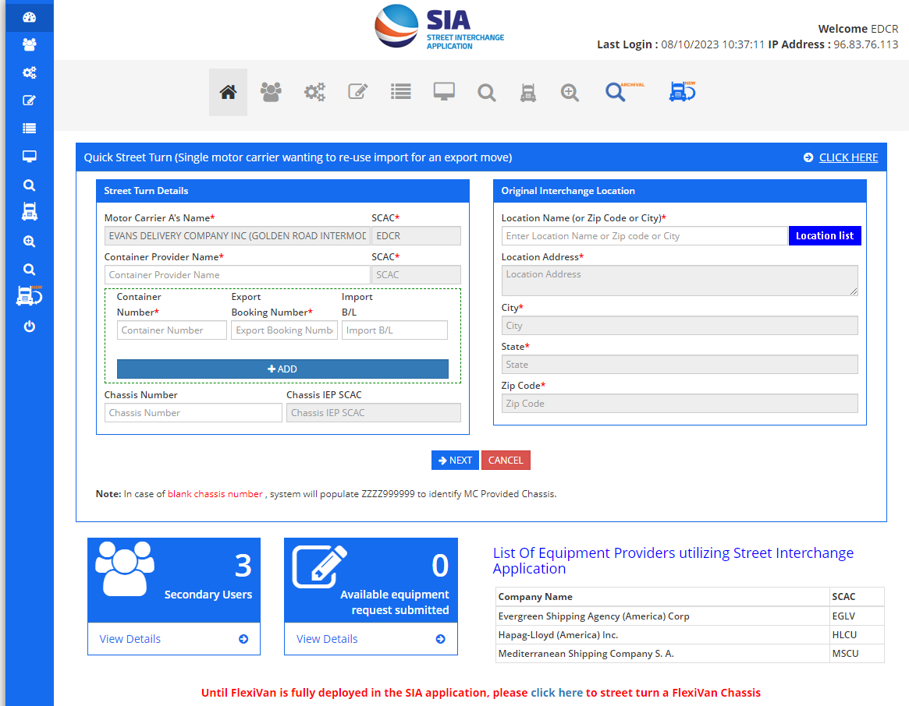
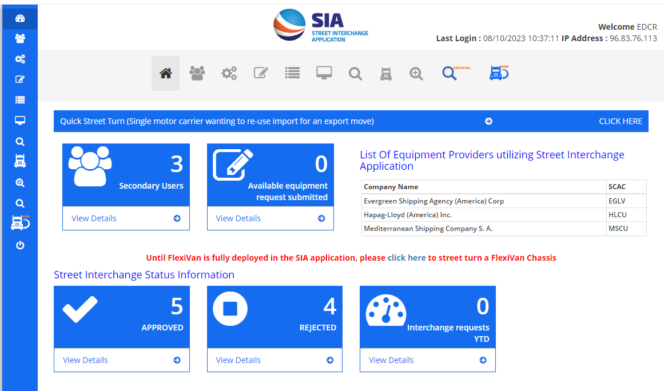
Request Street Turn via IANA’s SIA Application – Single MC requesting to reuse an import container as an export.
IANA’s Street Interchange Application (SIA) provides a web portal that streamlines and automates street interchanges and street turns for UIIA Motor Carriers and UIIA EPs.
UIIA EP’s currently utilizing the SIA application:
Evergreen, Mediterranean Shipping and Hapag Lloyd (only in LA/LB)
Click link or icon below to initiate street turn request
Enter mandatory fields for Street Turn Request which include:
Container Provider Name
Container Number
Export Booking Number
Originating Interchange Location (where unit outgated)
Note: Some EPs also require chassis number be provided.

Slide 31
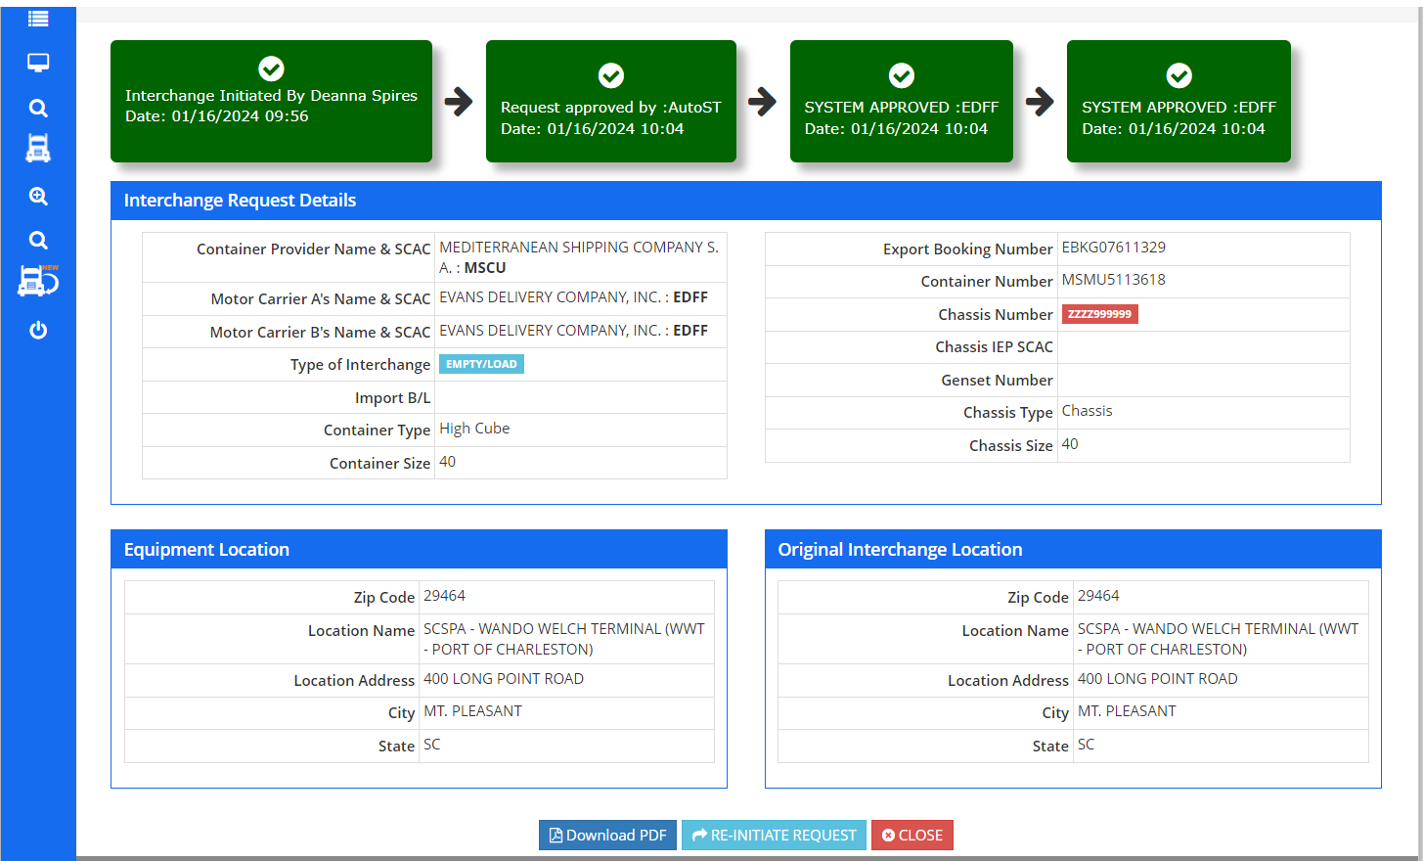
Street Turn Request/Approval Process
MC Street Turn Request is transmitted to the EP.
Once EP approves the request, the SIA system is updated to reflect the approval and notification is sent via e-mail to both MC & EP.
If transaction is rejected by EP, MC is notified via e-mail and the reason is for rejection is provided by EP
Questions related to rejections need to be directed to EP.

Slide 32
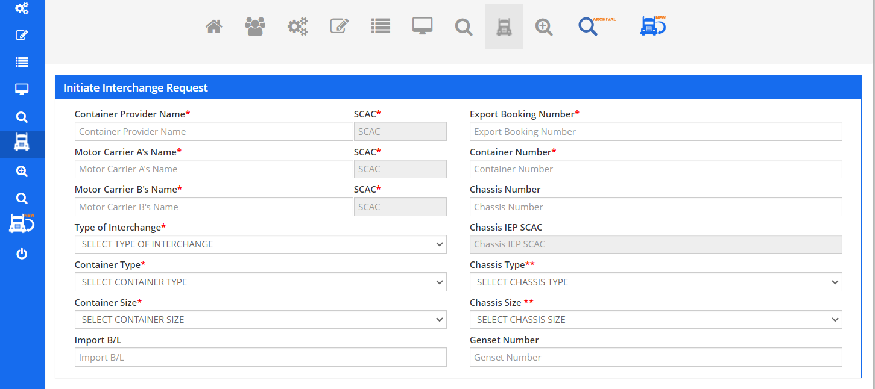
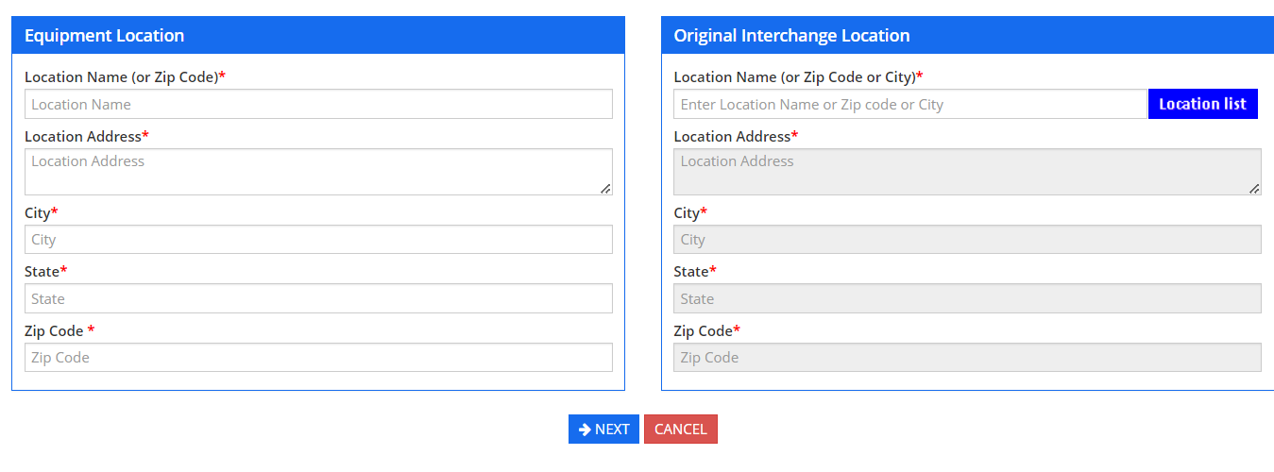
Request Street Interchange via IANA’s SIA Application – Interchange Between 2 Motor Carriers
Process for Street Interchange Requests
Enter Container EP Company Name.
Enter Motor Carrier A – Originating MC
Enter Motor Carrier B – Receiving MC
Select Type of Interchange
Container Type/Size
Export Booking Number
Container Number
Equipment Location – Where Equip. is Now.
Originating Interchange Location –Where Equip. Outgated
Note: Some EPs will require Chassis information also to be entered.

Slide 33
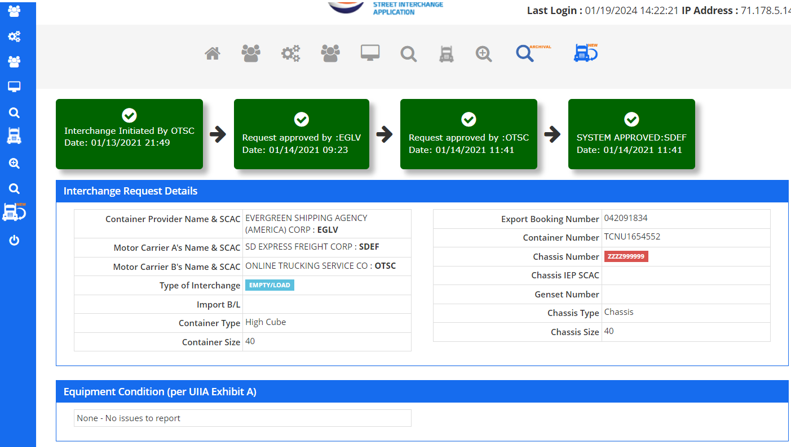
Street Interchange Request/Approval Process
Approval/Rejection Process for Street Interchange Requests
Request is sent to the Container EP and MC A.
Once EP approves request, an email is sent all parties.
MC B (Receiving MC) will go into SIA application and do pre-trip inspection based on Exhibit A in UIIA to identify the condition of the equipment being received by MC B.
If no issues noted, then system will approve the street interchange transaction and all parties will be notified.
If Exhibit A issues identified, then MC A is notified. If they disagree with MC B’s pre-trip inspection, then can reject the transaction and all parties will be notified via e-mail.

Slide 34
Contact Details: General Inquiries (re: insurance updates, issues at terminals, etc.): uiia@intermodal.org UIIA Issues (Related to On-going business issues related to provisions in the UIIA): uiiaissues@uiia.org VP Information Services: Debbie Sasko debbie.sasko@intermodal.org Info Services Program Managers: Stacie Fagan Stacie.Fagan@intermodal.org Sherry Parnell Sherry.Parnell@intermodal.org

